Slide 1
NLP 220 Section 4
Class Assignment 1& ML Quiz 1 Review,
Gaussian vs. Multinomial Naive Bayes, Ginni Index

Slide 2
Outline (starting ~3:35)
Review of Class Assignment 1/Common Errors
An aside on GaussianNB vs MultinomialMB
Review of ML Quiz 1

Slide 3
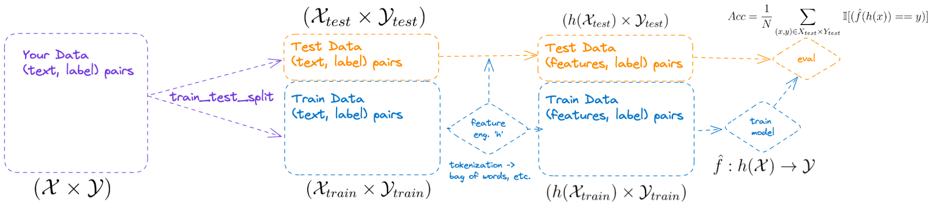
ML for text-classification overview

Slide 4
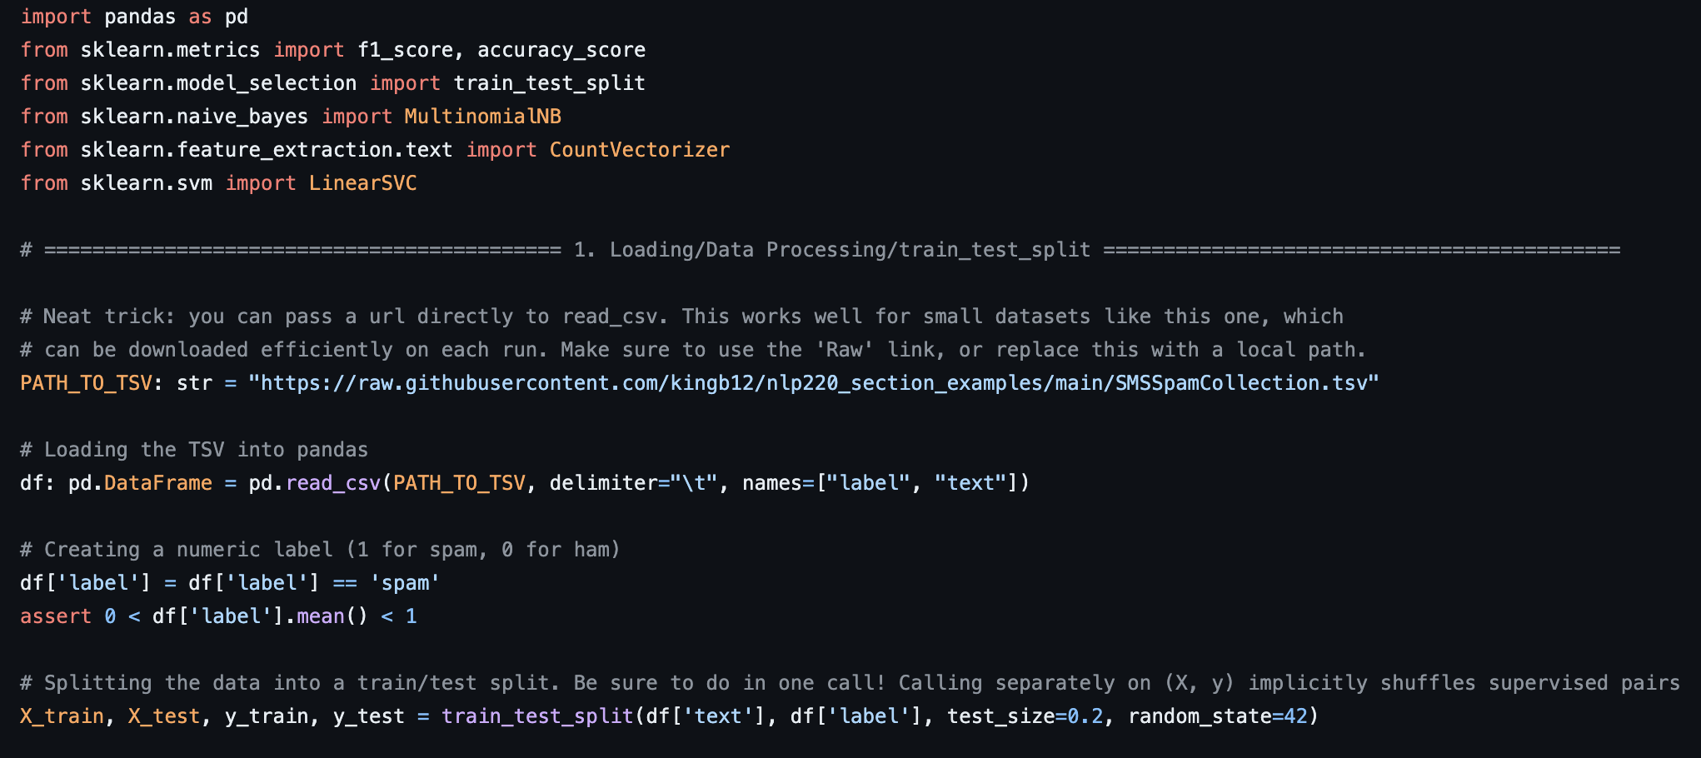
Class Assignment 1 Example
Loading, Processing, Splitting Data

Slide 5
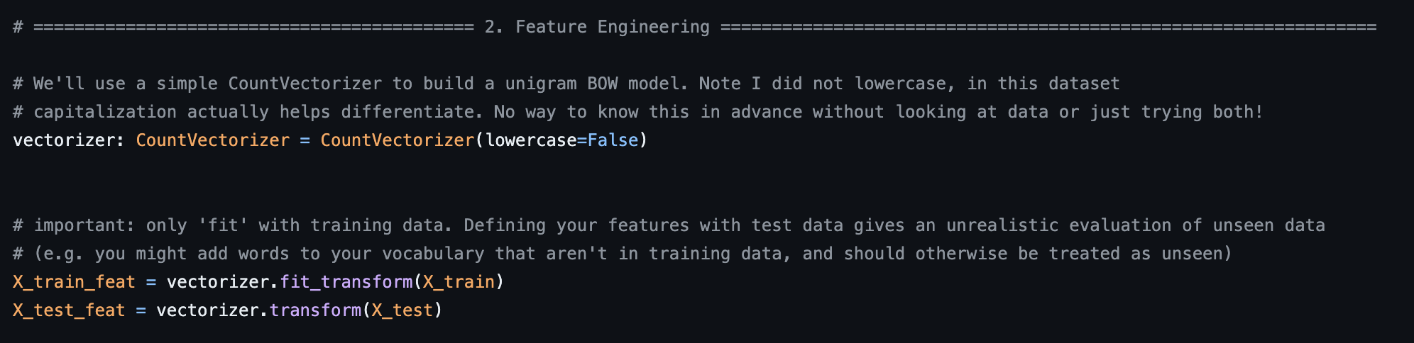
Class Assignment 1 Example

Slide 6
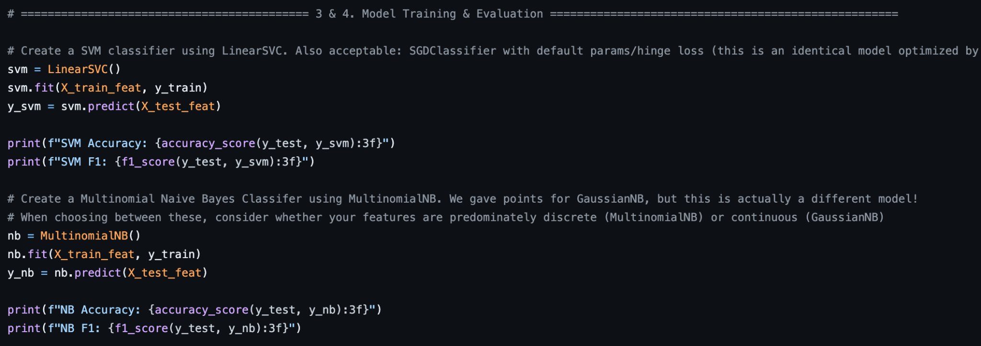
Class Assignment 1 Example

Slide 7
Common Error: fit_transform on test data
Why not?

Slide 8
Common Error: fit_transform on test data
Why not: Test data evaluation is your unbiased estimate of deployed performance. If you define your features with it, you can’t use it to estimate performance on data you haven’t used to define features

Slide 9
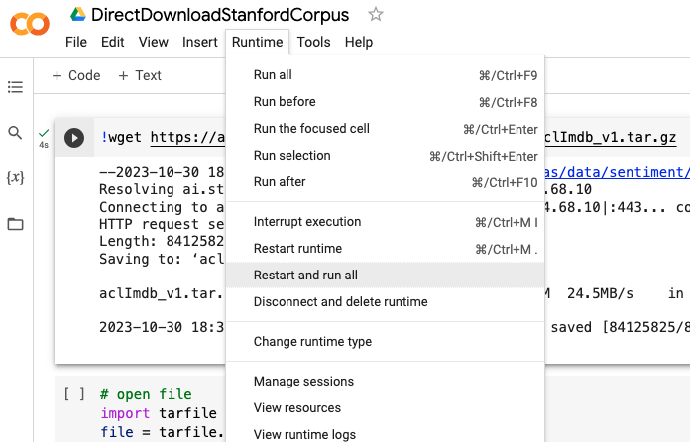
Common Error: non-exectutable code from notebooks

Slide 10
GaussianNB vs MultinomialNB
Both work, we did not specify, so no points deducted, but worth thinking about: GaussianNB and MultinomialNB make different assumptions about features:
Multinomial Naive Bayes assumes a feature vector where each element represents the number of times it appears (or, very often, its frequency).
I.e, features are distributed by a Multinomial distribution
The Gaussian Naive Bayes, instead, is based on a continuous distribution characterised by mean & variance. It is suitable for more generic classification tasks.¹
I.e. features are assumed to be distributed as some Gaussian (a good default for any continuous RV for which you don’t know the distribution)

Slide 11
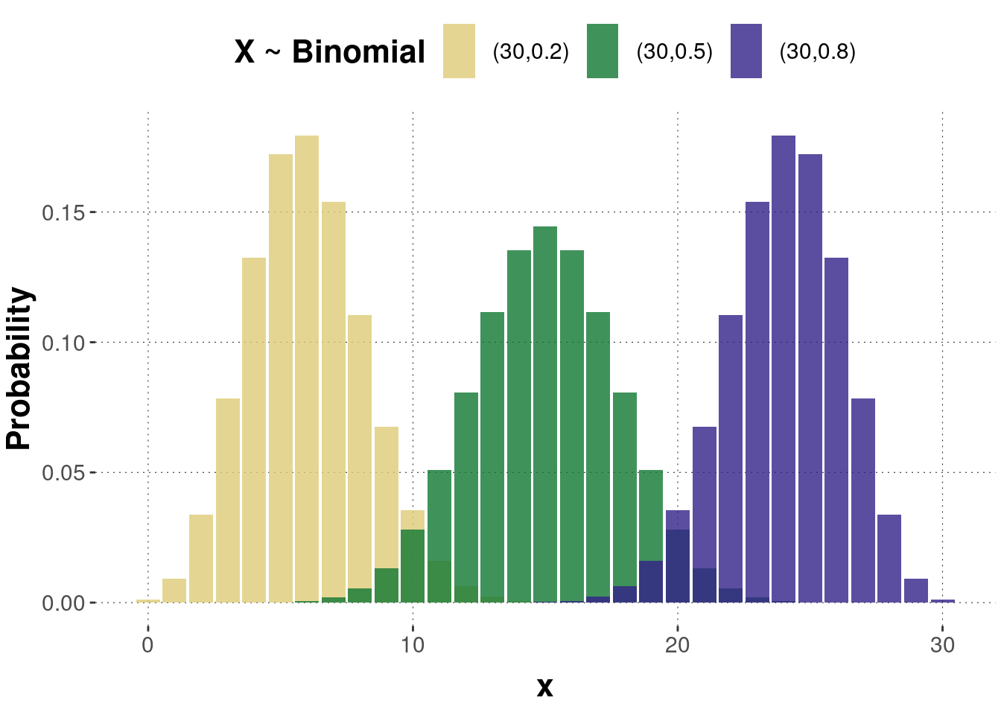
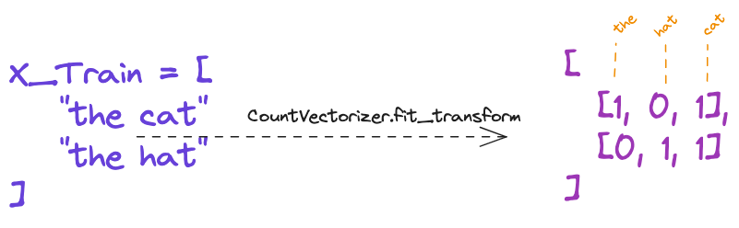
Multinomial Distribution: counts and frequencies (i.e. if you use CountVectorizer)

Slide 12
Gaussian/Normal Distribution: typical for use with unknown continuous RVs
Occurs often as sums of i.i.d. RVs are normally distributed in the limit
Often a suitable approx for other distributions, like multinomials!^{(sec 15)}
Why?

Slide 13
Gaussian/Normal Distribution: typical for use with unknown continuous RVs
Occurs often as sums of i.i.d. RVs are normally distributed in the limit
Often a suitable approx for other distributions, like multinomials!^{(sec 15)}
Why? Sum of Categorical RV’s

Slide 14
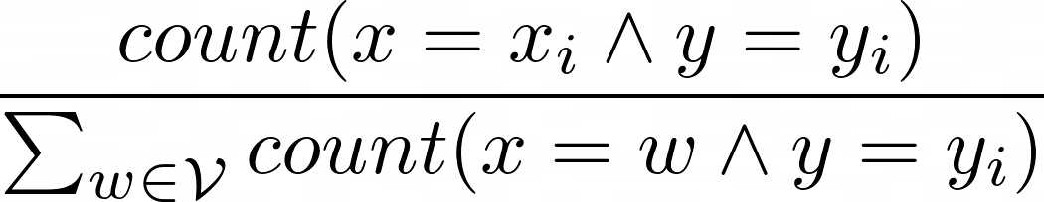
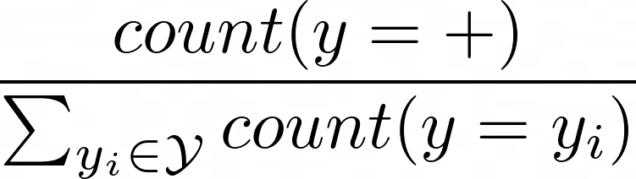
Estimating p(x_{i} | y) and p(y)
 | Max. Likelihood Estimate (MLE) | Add-1 Smoothing (MAP estimate)
p(x_{i} | y = +) | Word-count(word) in positive docs / total word-count in positive docs
p(y = +) | Raw frequency of class (num. + docs / num. total docs):

Slide 15
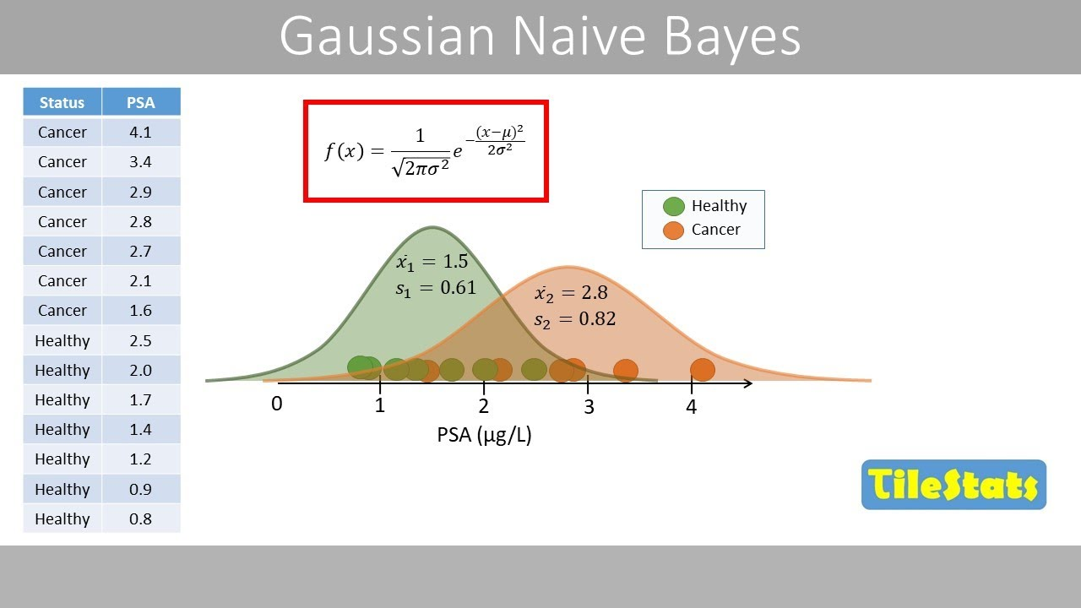
Gaussian Naive Bayes

Slide 16
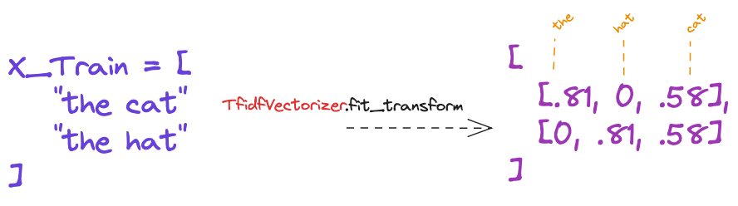
GaussianNB is a good choice for TfidfVectorizer features:
The Gaussian Naive Bayes, instead, is based on a continuous distribution characterised by mean & variance. It is suitable for more generic classification tasks.¹

Slide 17
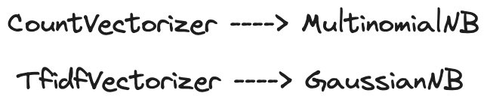
TLDR:

Slide 18
MLQuiz1 Review
Q: A machine learning problem involves four attributes plus a class. The attributes have 3, 2, 2, and 2 possible values each. The class has 4 possible values. How many maximum possible different examples are there?
A:

Slide 19
MLQuiz1 Review
Q: A machine learning problem involves four attributes plus a class. The attributes have 3, 2, 2, and 2 possible values each. The class has 4 possible values. How many maximum possible different examples are there?
A:
An example = (x, y) = ([x₁, x₂, x₃, x₄], y)
Total number =

Slide 20
MLQuiz1 Review
Q: If N is the number of instances in the training dataset, nearest neighbors has a classification run time of
A:

Slide 21
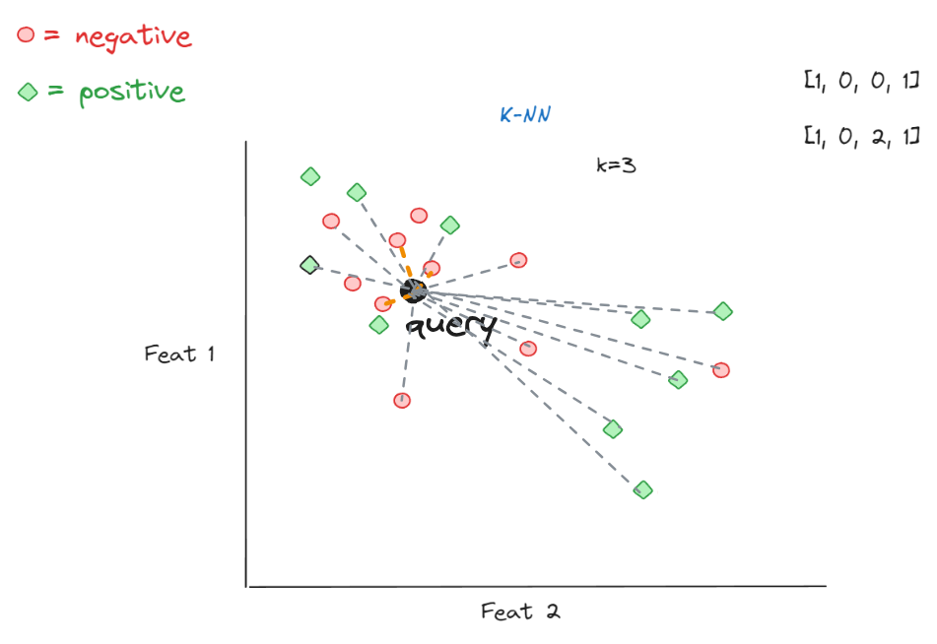
MLQuiz1 Review
Q: If N is the number of instances in the training dataset, nearest neighbors has a classification run time of
A: O(N)
I had discussed a KDtree which has average (not worst) log(N) on randomly distributed spatial data

Slide 22
MLQuiz1 Review
Q: A project team performed a feature selection procedure on the full data set and reduced their large feature set to a smaller set. Then they split the data into test and training portions. They built their model on training data using several different model settings, and report the best test error they achieved. This setup is:
Problematic
Good
Best
Cannot be decided

Slide 23
MLQuiz1 Review
Q: A project team performed a feature selection procedure on the full data set and reduced their large feature set to a smaller set. Then they split the data into test and training portions. They built their model on training data using several different model settings, and report the best test error they achieved. This setup is:
Problematic
Good
Best
Cannot be decided

Slide 24
MLQuiz1 Review
Q: A and B are two events. If P(A, B) decreases while P(A) increases, which of the following is true?
P(B) decreases
P(B|A) decreases
All of the above
P(A|B) decreases

Slide 25


MLQuiz1 Review
Q: A and B are two events. If P(A, B) decreases while P(A) increases, which of the following is true?
P(B) decreases
P(B|A) decreases
All of the above
P(A|B) decreases
Multiply both by P(A), divide by P(B|A)

Slide 26
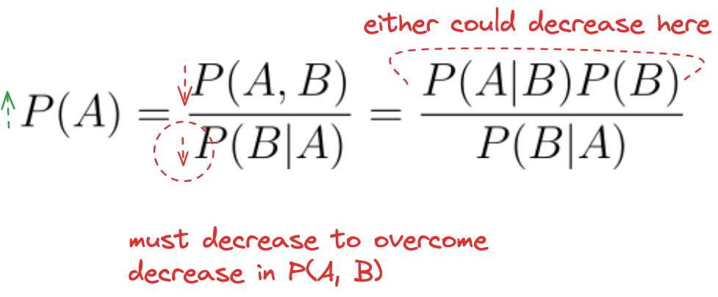
MLQuiz1 Review
Q: A and B are two events. If P(A, B) decreases while P(A) increases, which of the following is true?
P(B) decreases
P(B|A) decreases
All of the above
P(A|B) decreases
Multiply both by P(A), divide by P(B|A)

Slide 27
MLQuiz1 Review
Q: Which of the following statements about Naive Bayes is incorrect?
Attributes are equally important.
Attributes can be nominal or numeric,
Attributes are statistically dependent of one another given the class value.
Attributes are statistically independent of one another given the class value.

Slide 28
MLQuiz1 Review
Q: Which of the following statements about Naive Bayes is incorrect?
✅ Attributes are equally important.
✅ Attributes can be nominal or numeric,
✅ Attributes are statistically independent of one another given the class value.
❌ Attributes are statistically dependent of one another given the class value.

